Slide 1
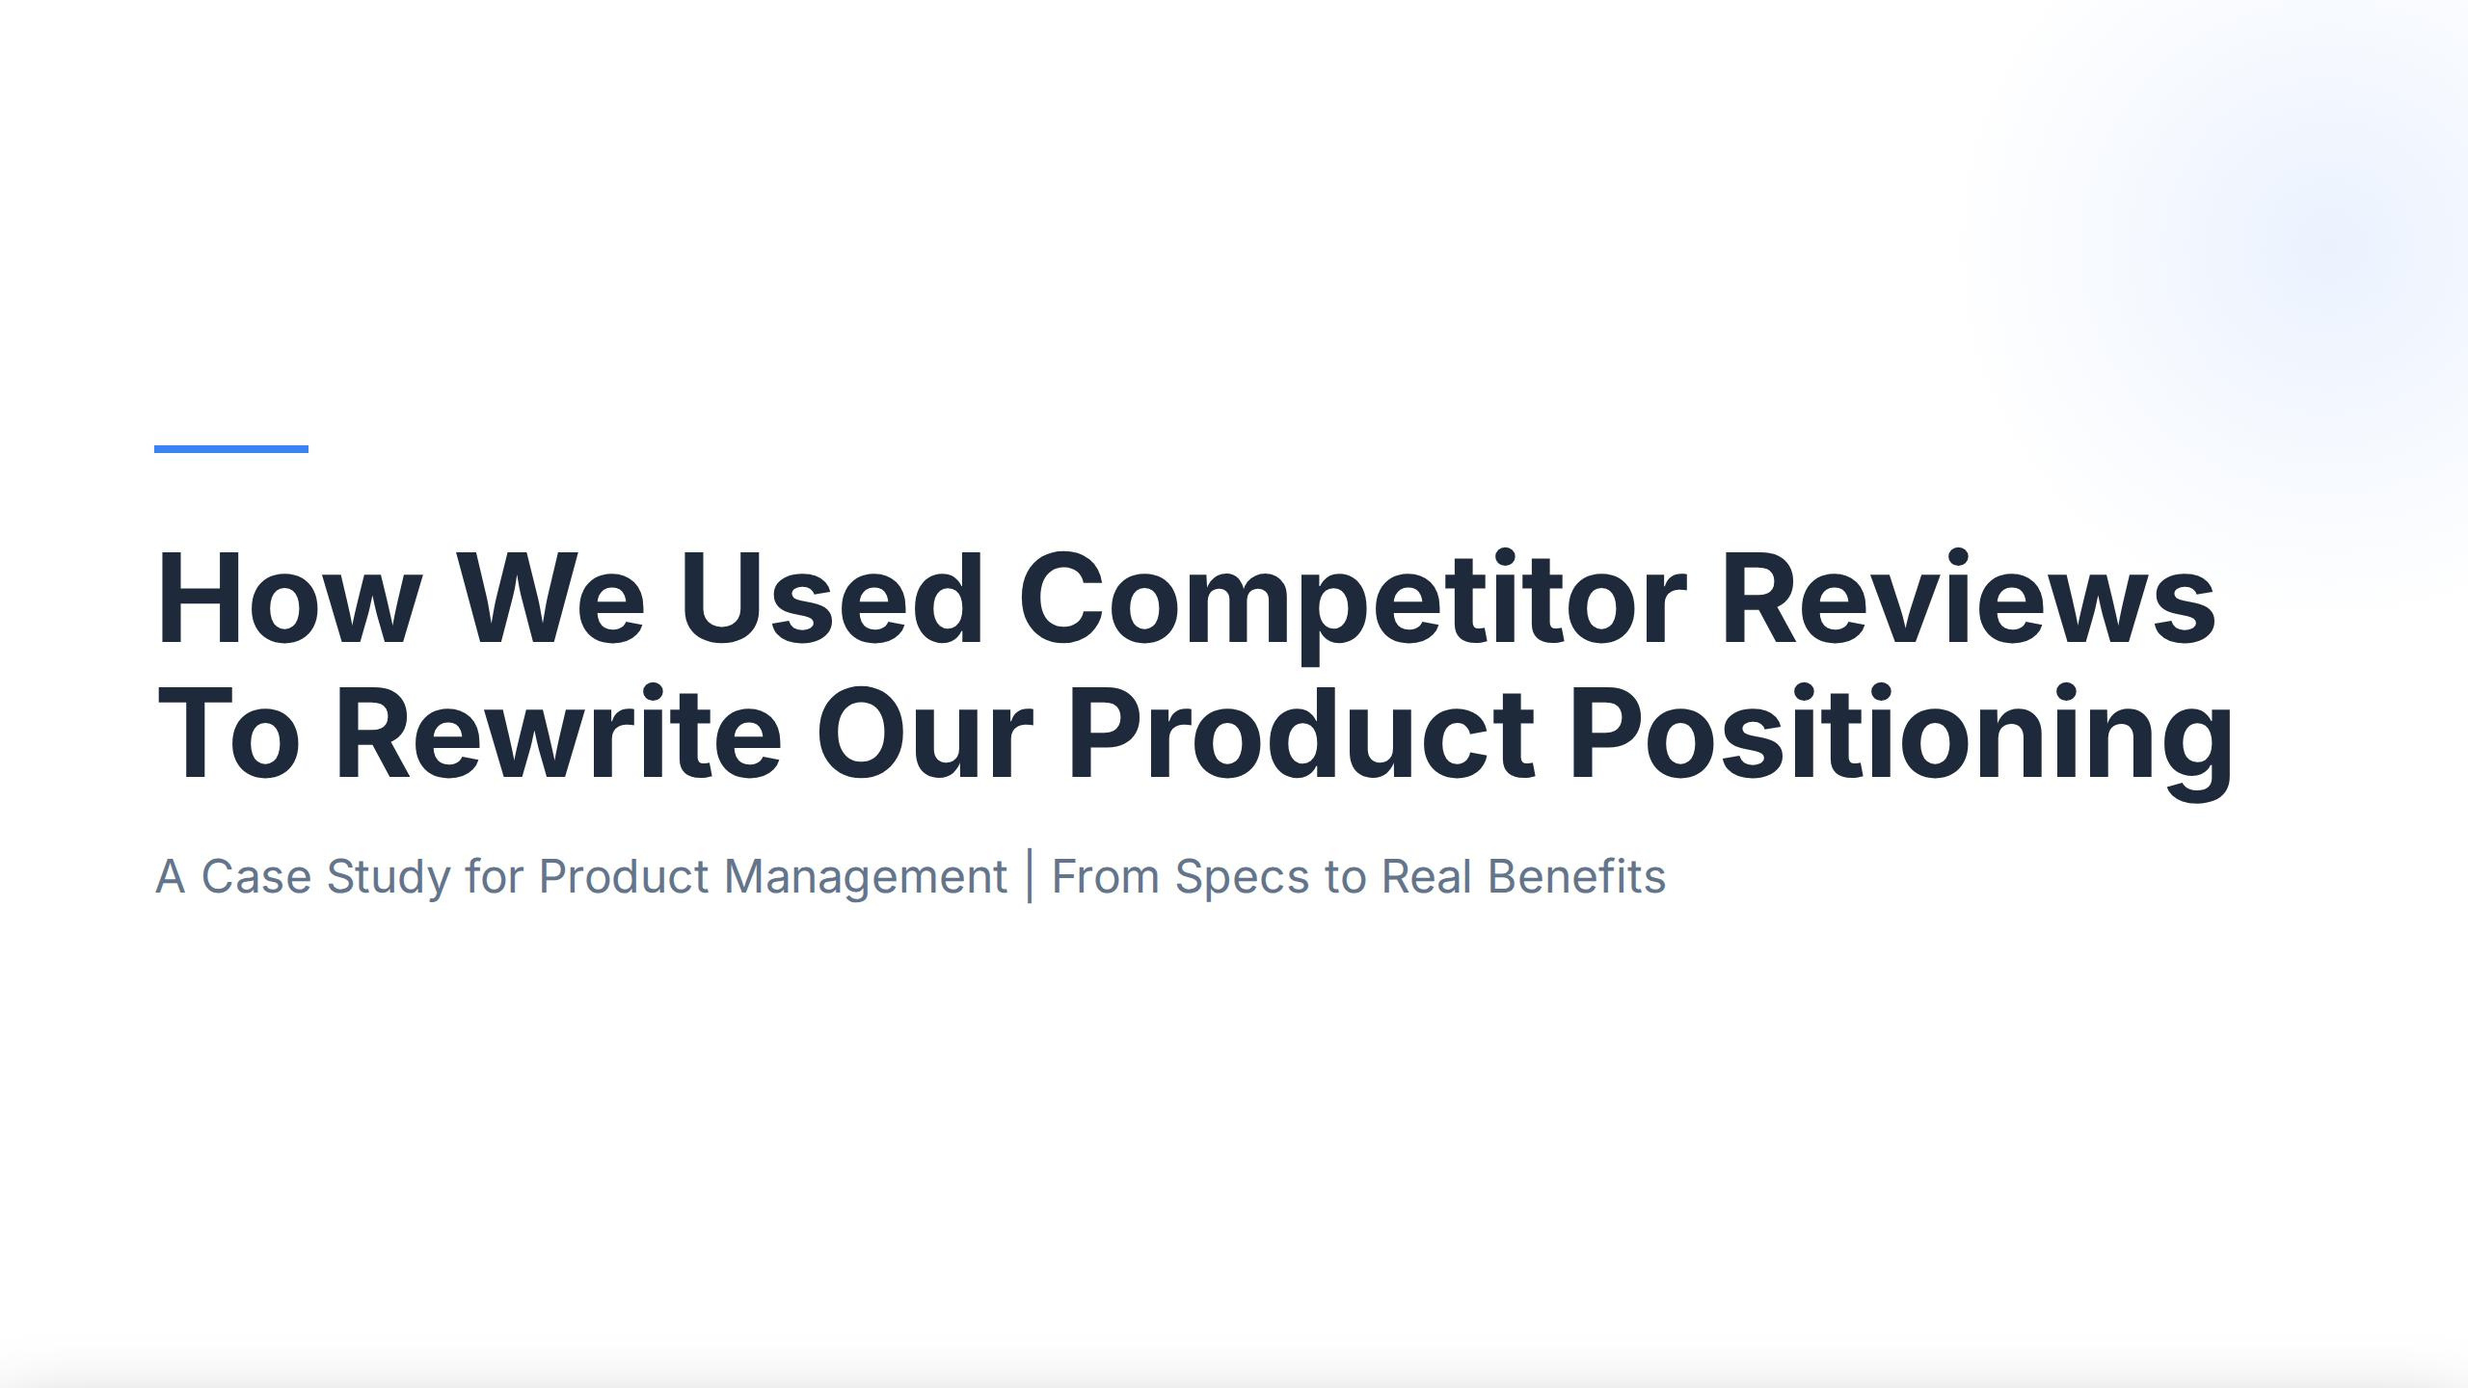
How
We
Used
Competitor
Reviews
Our Product
Positioning
To Rewrite
A
Case
Study
for
Product
Management
From
Specs
to
Real Benefits

Slide 2
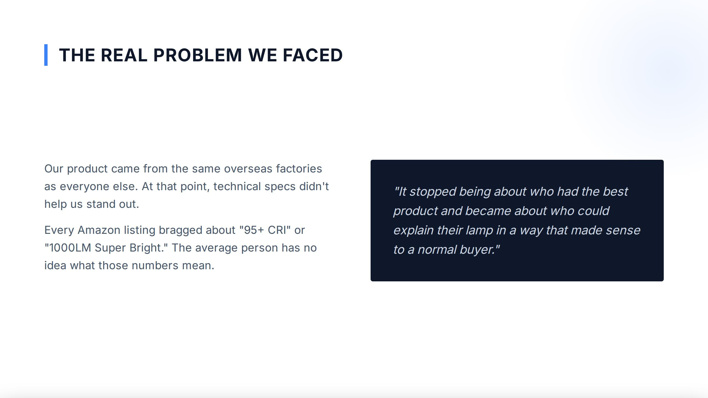
THE REAL
PROBLEM WE
FACED
Our
product
came
from the
same overseas
factories
else. At that
as
everyone
point, technical
specs
didn't
"It
stopped
being
about
who had the best
help
us
stand
out.
product
and became about who could
Every
Amazon
listing bragged
about "95+ CRI"
explain
their
lamp
in
way
that made
or
a
sense
"1000LM
Super
Bright."
The
average person
has
no
to
a
normal
buyer."
idea what those numbers
mean.

Slide 3
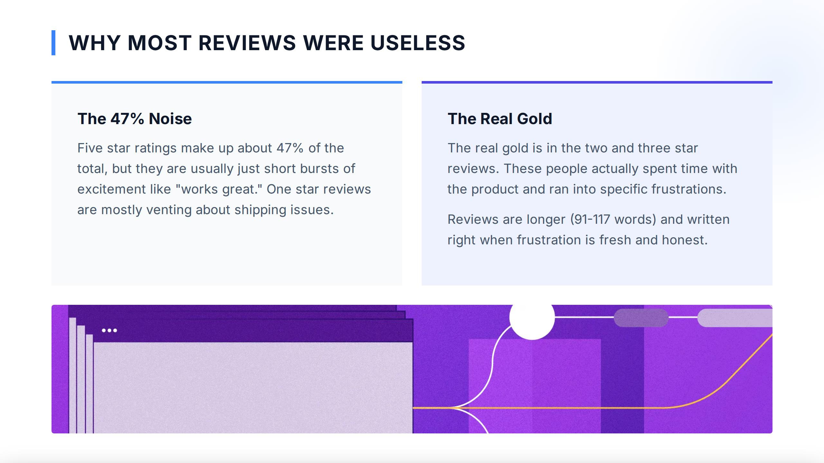
WHY MOST REVIEWS
WERE
USELESS
The
47% Noise
Real
Gold
The
ratings
make up about 47% of the
gold
and
Five star
total, but they
The real
is in
the
two
three star
usually
just
short bursts
of
reviews.
These
people actually spent
time with
are
product
specific
excitementlike "works
great."
One starreviews
the
and
ran
into
frustrations.
are
mostly
venting
about
shipping
issues.
longer
(91-117
words)
and written
Reviews are
right
when
frustration
is
fresh
and
honest.

Slide 4
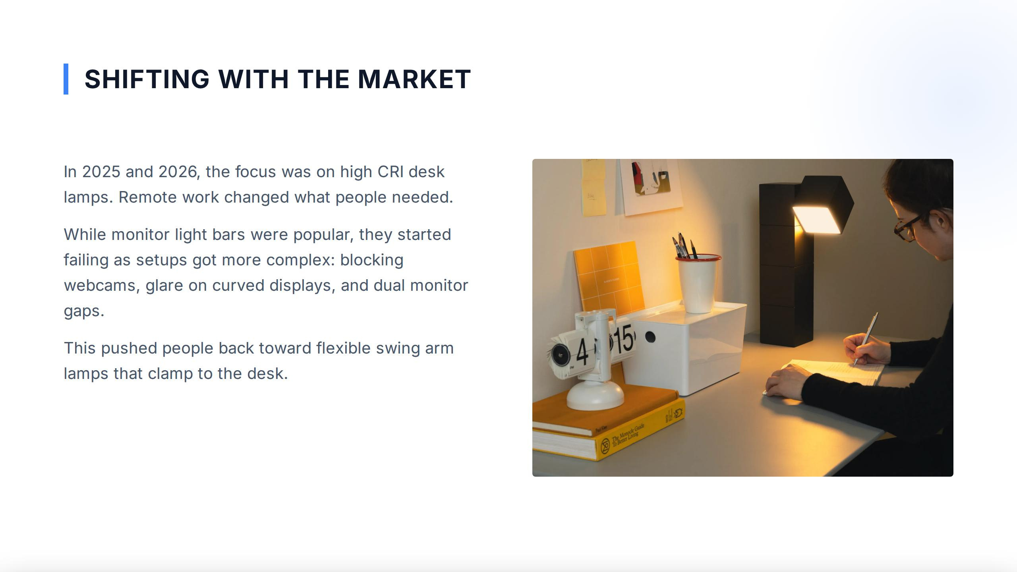
SHIFTING
WITH
THE
MARKЕТ
In 2025 and 2026, the focus
was on
high CRI desk
lamps.
Remote work
changed
what
people
needed.
While
monitor
light
bars
popular,
they
started
were
failing
as
setups got
more
complex:
blocking
webcams, glare
on curved
displays,
and dual monitor
gaps.
4i
$15
This
pushed
people
back
toward flexible
swing
arm
lamps
that
clamp
to
the desk.

Slide 5
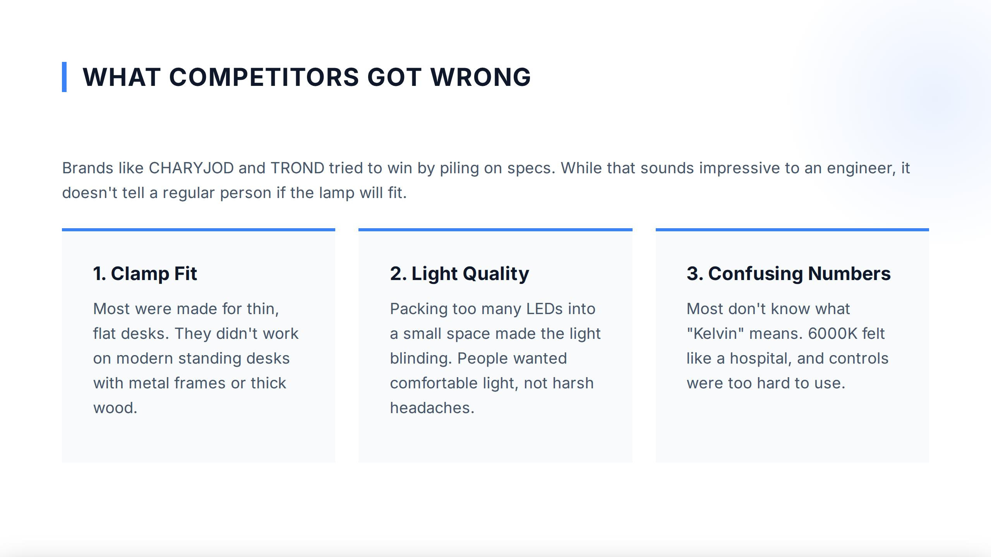
WHAT
COMPETITORS GOT WRONG
Brands
like
CHARYJOD
and
TROND tried to
win
by piling
on
specs.
While
that
sounds
impressive
to
an
engineer,
it
doesn't tell a
regular
person
if
the
lamp
will fit.
1.
Clamp
Fit
2.
Light
Quality
3.
Confusing
Numbers
Most
were
made
for
thin,
Packing
too many
LEDs
into
Most
don't know what
flat desks.
They
didn't work
small
the
light
"Kelvin"
6000K felt
a
blinding.
space made
means.
on
modern
standing
desks
People
wanted
like
a
hospital,
and controls
with metal
frames
or
thick
comfortable
light,
not harsh
were
too hard to
use.
wood.
headaches.

Slide 6
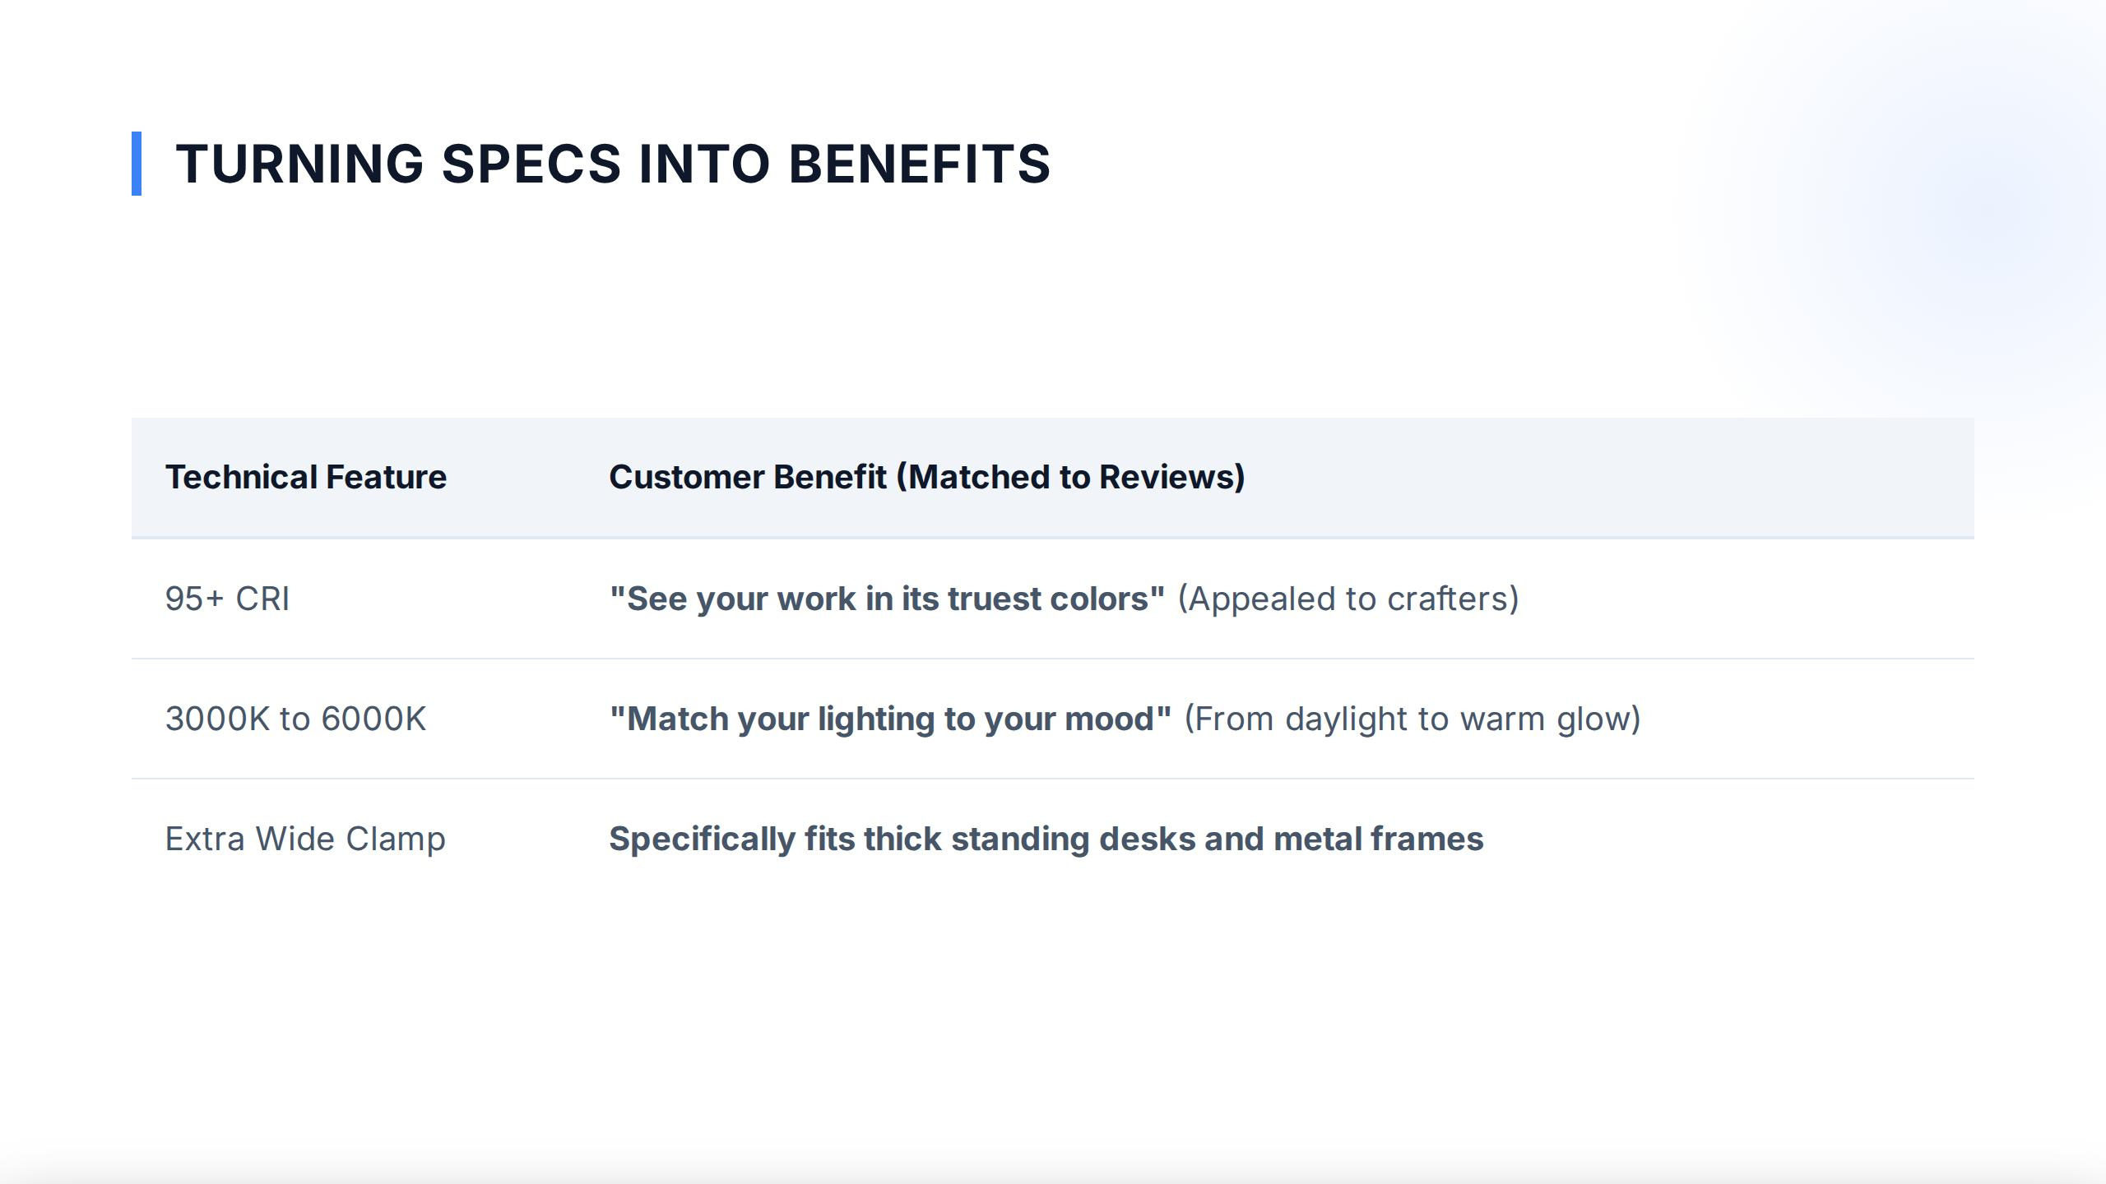
TURNING
SPECS
INTO
BENEFITS
Technical
(Matched
Reviews)
Feature
Customer
Benefit
to
95+ CRI
work
(Appealed
crafters)
"See your
in its truest colors"
to
3000K to
6000K
"Match
your
lighting
to
your
mood"
(From
daylight
to
warm
glow)
Extra
Wide
Clamp
Specifically
fits
thick
standing
desks and metal
frames

Slide 7
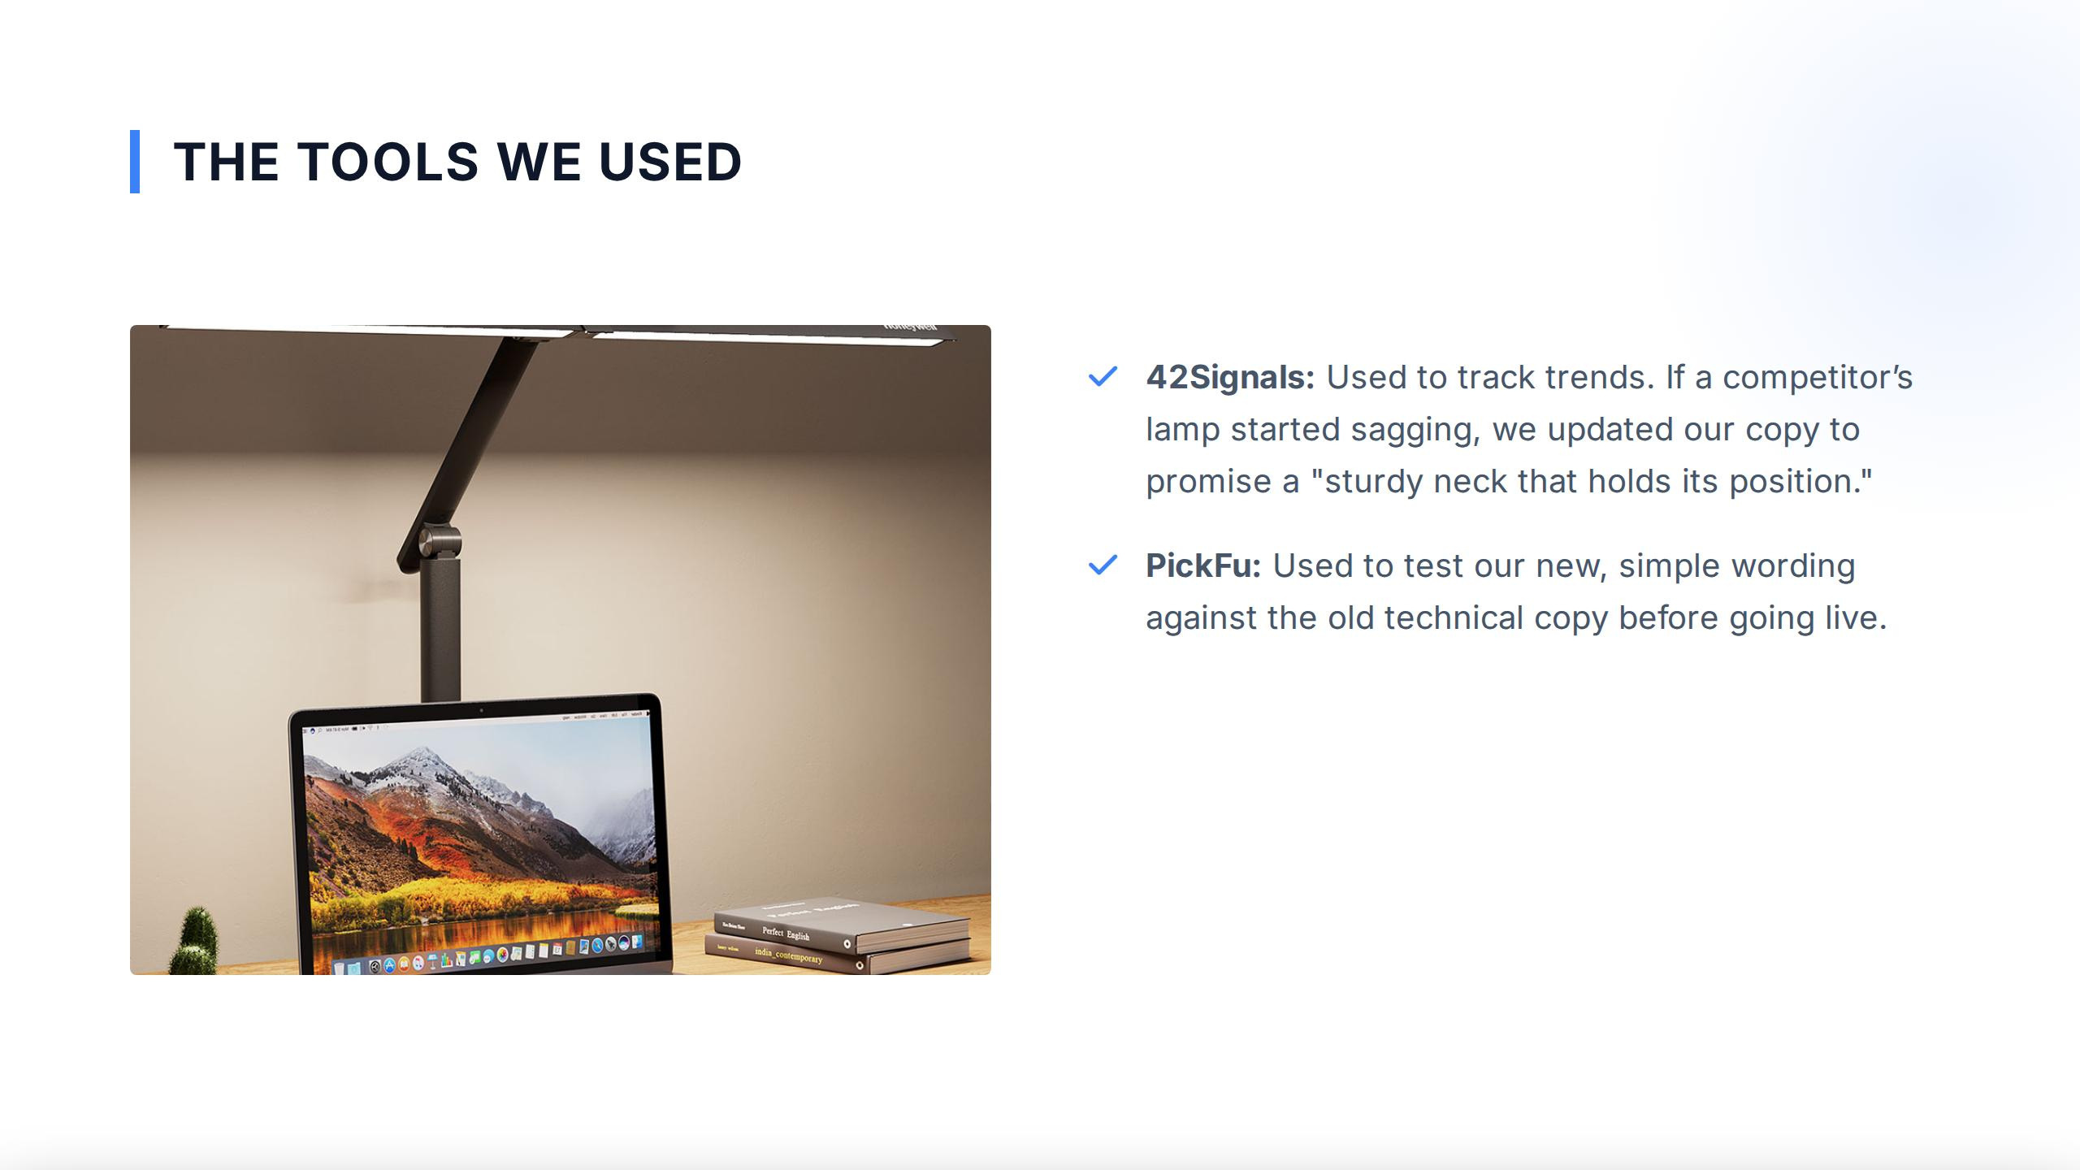
THE TOOLS
WE
USED
42Signals:
Used to
track trends.
competitor's
If
a
lamp
started
sagging,
we
updated
our
copy to
promise
"sturdy
neck that
holds its
position."
a
☑
PickFu: Used
to test
simple
wording
our new,
against
theold technical
copy
before
going
live.
Perfect
Eagi

Slide 8
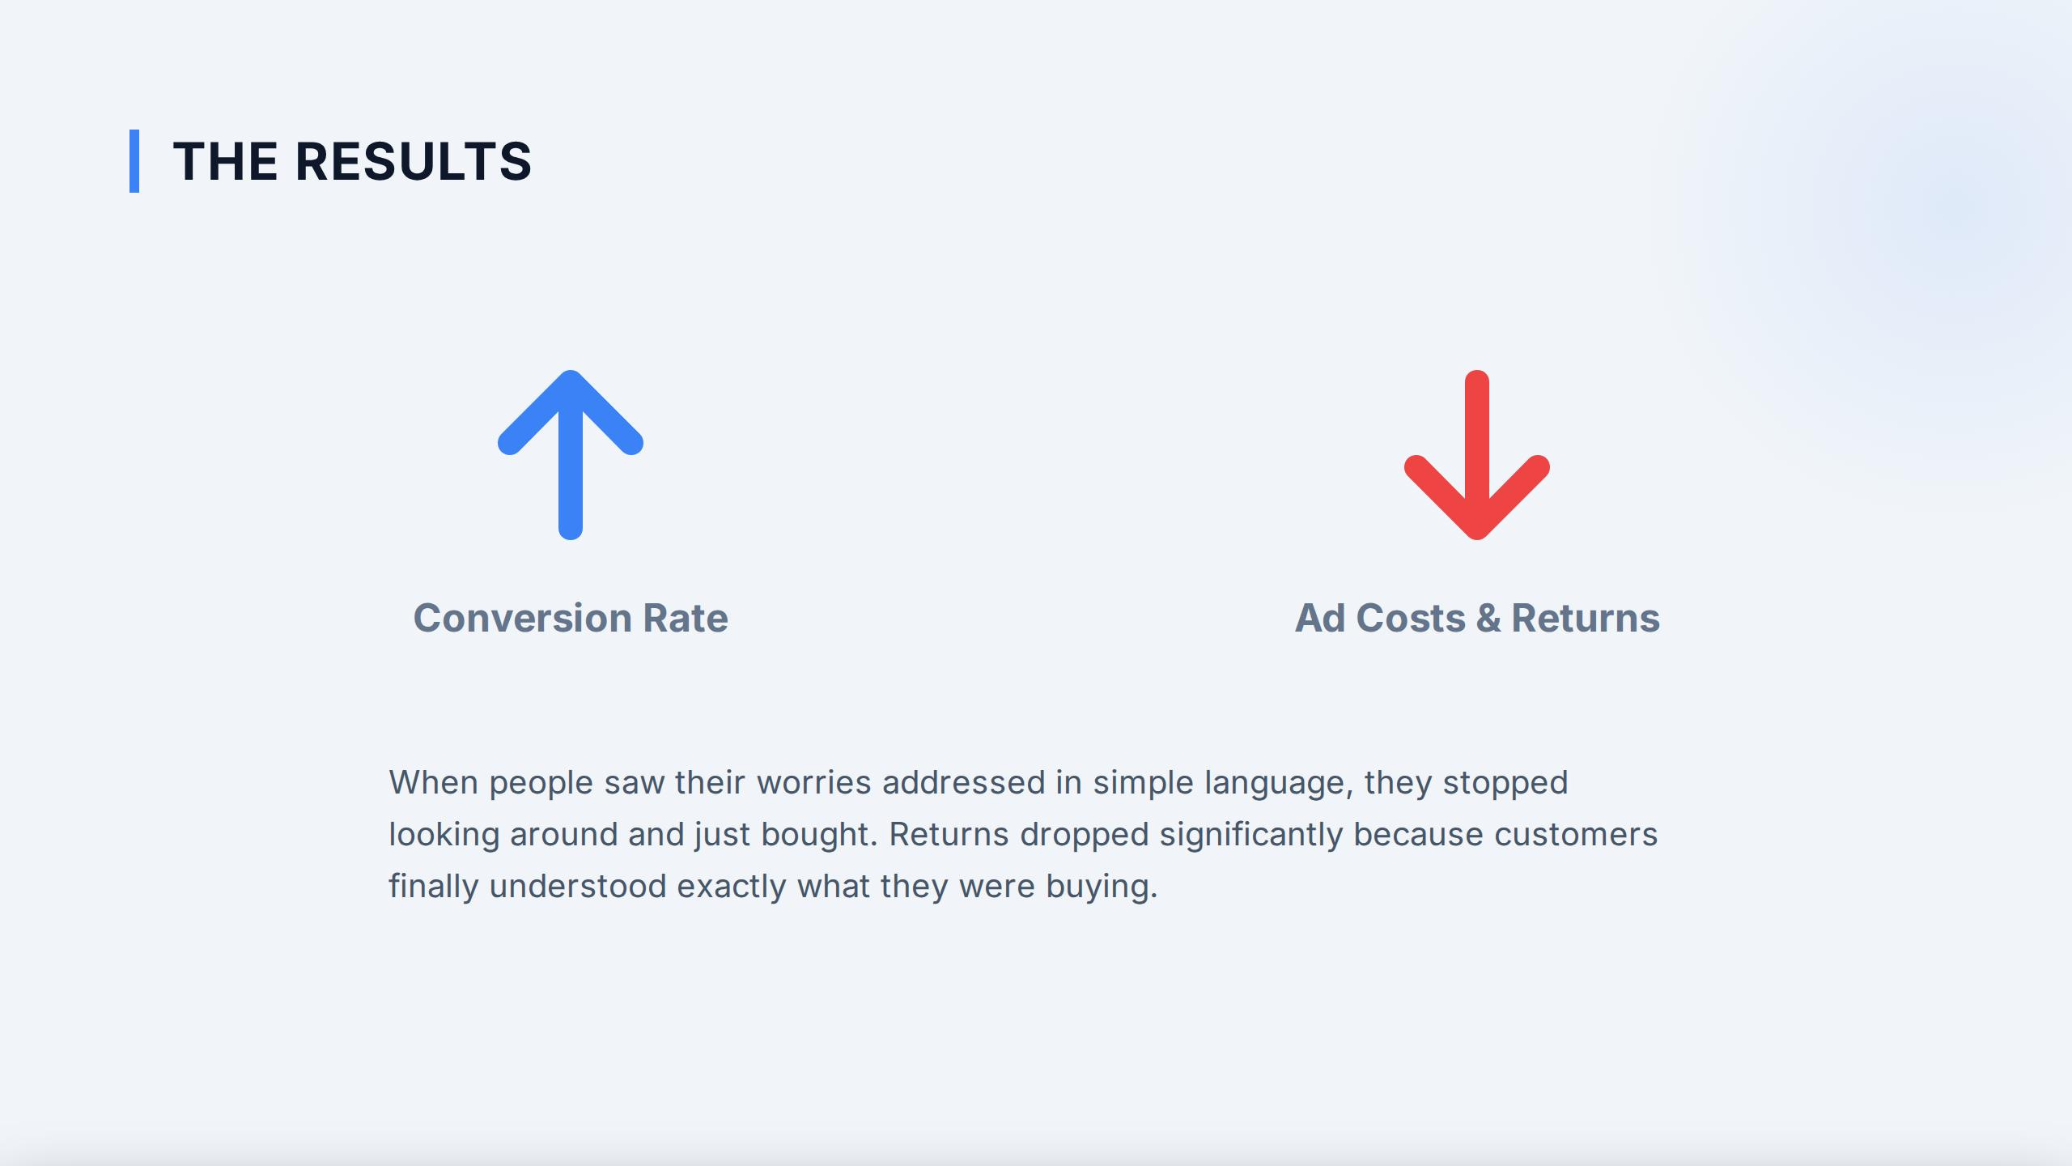
THE RESULTS
↓
Conversion Rate
Ad
Costs&Returns
When
people
saw
their worries addressed in
simple language, they
stopped
looking
around and
just
bought.
Returns
dropped significantly
because customers
finally
understood exactly what
they
were
buying.

Slide 9
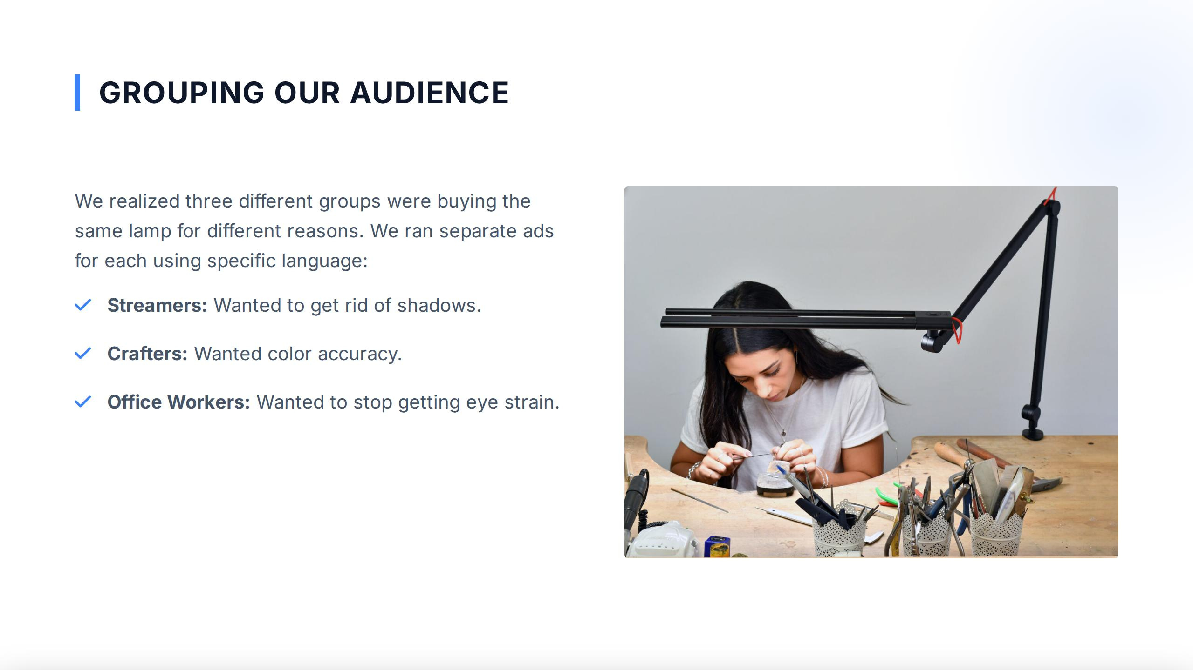
GROUPING
OUR
AUDIENCE
We
realized
three
different
groups
were
buying
the
same
lamp
for different
reasons.
We
ran
separate
ads
for each
using
specific
language:
Streamers:
Wanted to
get
rid of
shadows.
Crafters:
Wanted
color
accuracy.
Office Workers: Wanted
to stop
getting
eye
strain.

Slide 10
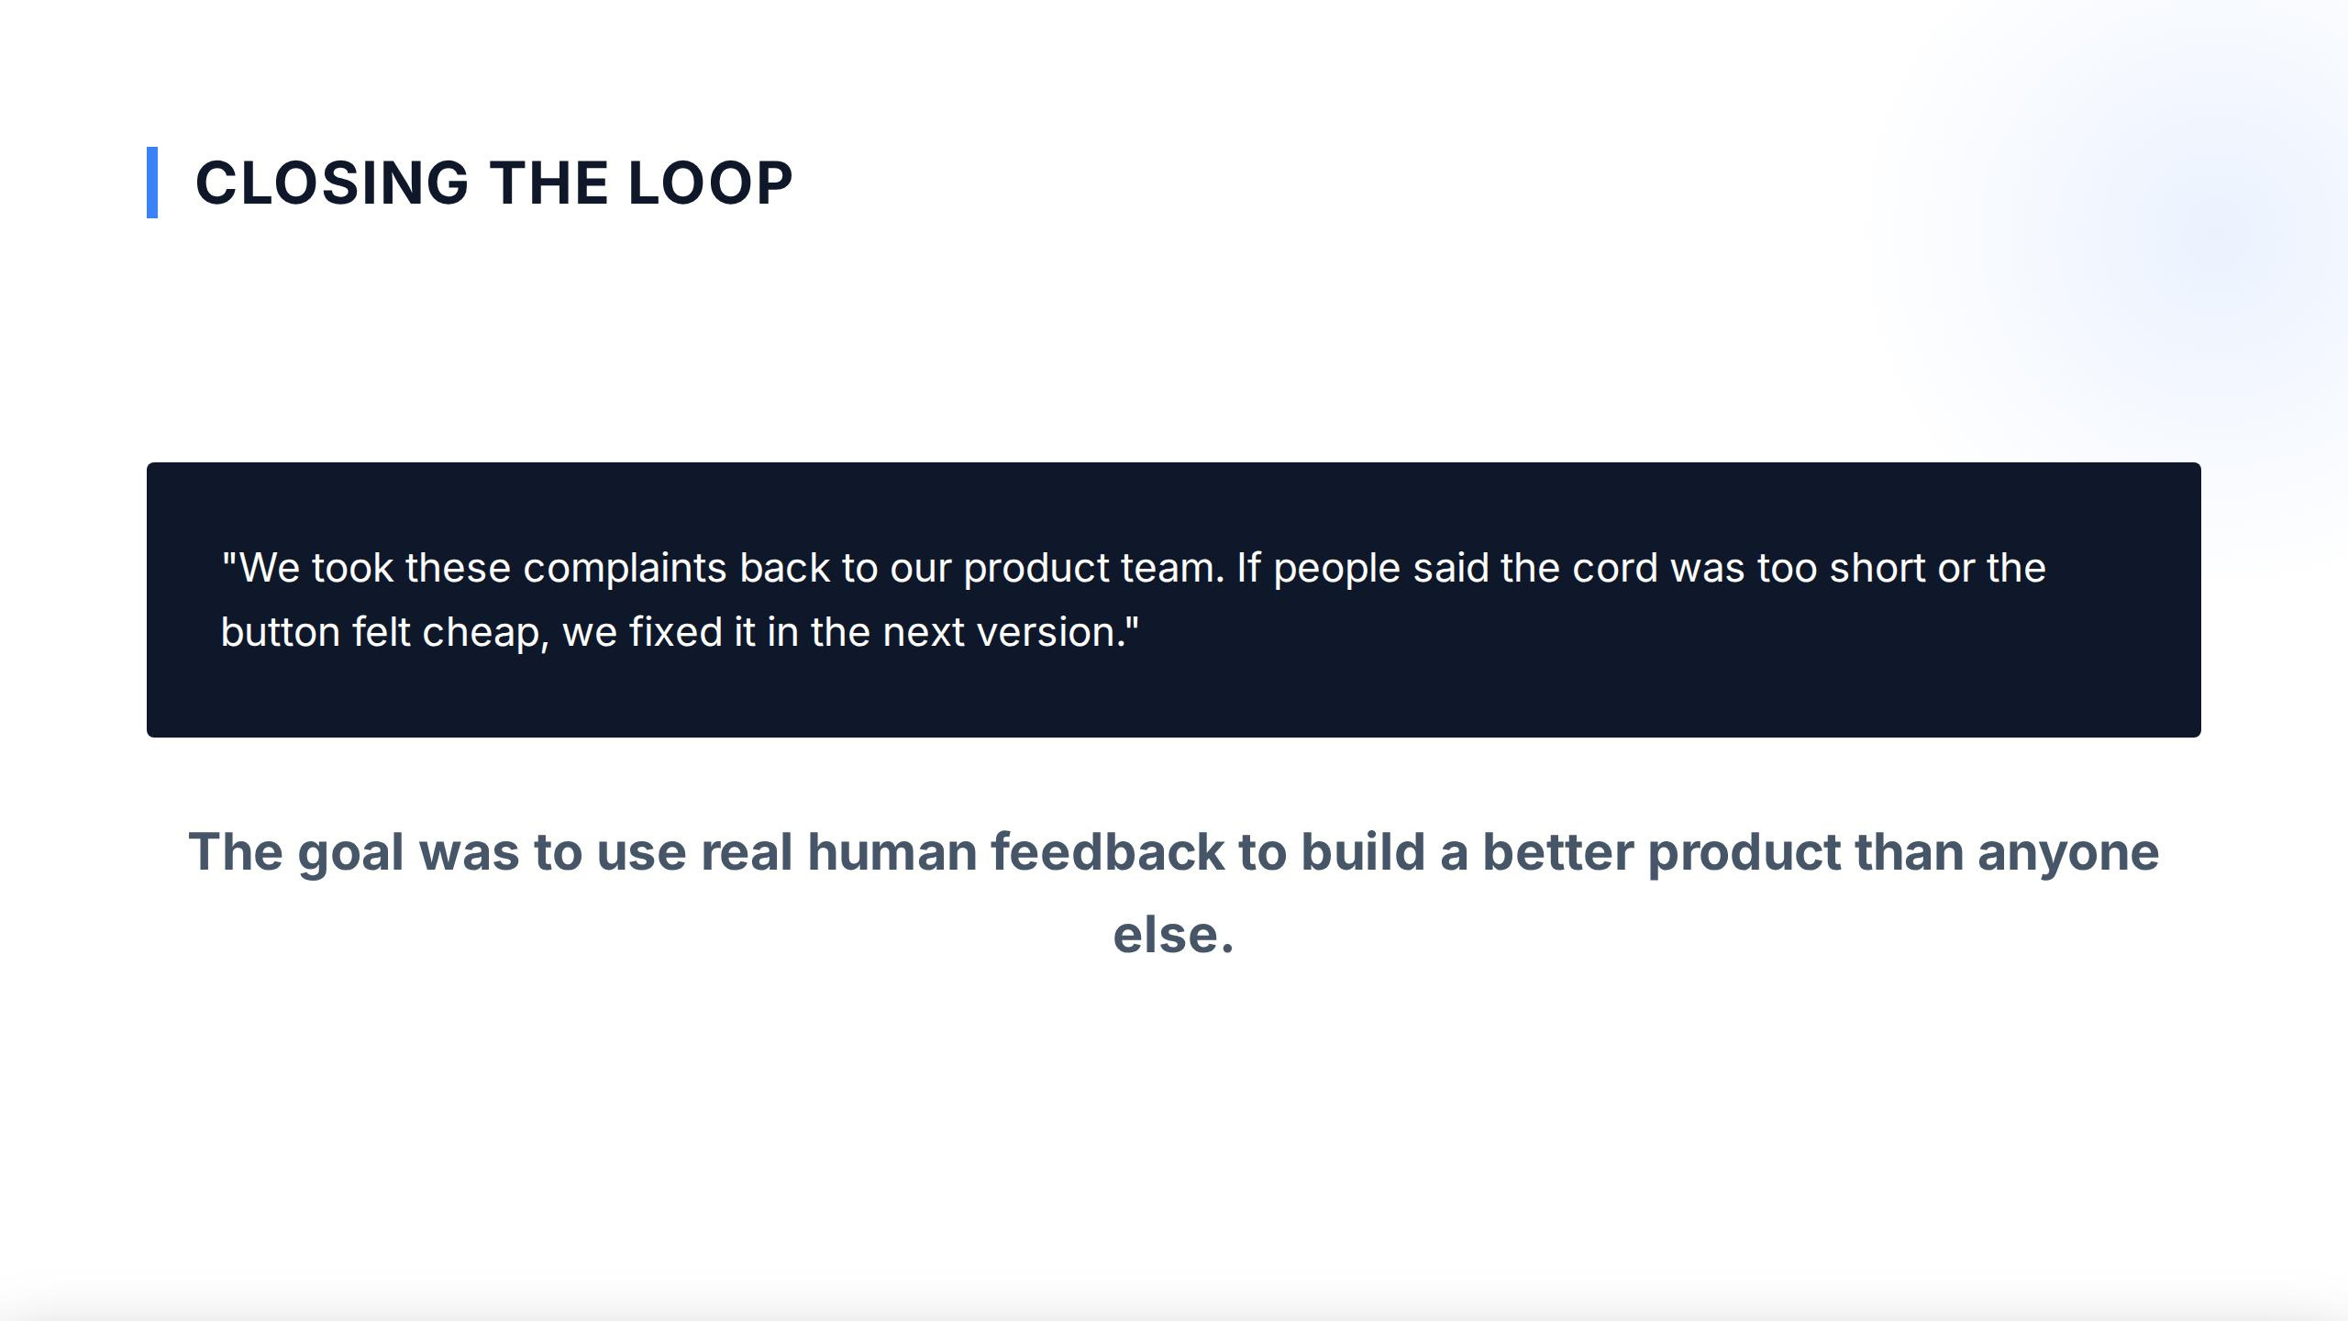
CLOSING THE
LOOP
"We took these
complaints
back
to
our
product team.
If
people
said the
cord
was
too
short
or
the
button felt
cheap, we fixed
it
inthe
next
version."
The
goal
was
to
use
real
human feedback to build a better
product
than
anyone
else.

